Slide 1
Managing your career and becoming a Leader
May 2016

Slide 2
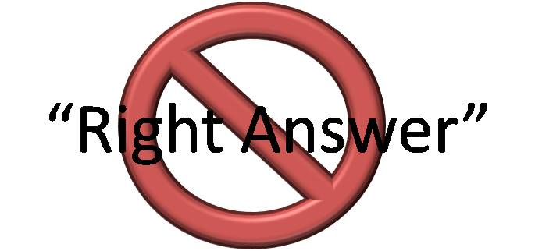
What does it mean to be a Leader?
There is no one right answer
It is usually situational
It is transitory
My personal favorite…
“A Leader is someone who has Followers. Leadership is all about Followership”
Peter Drucker

Slide 3
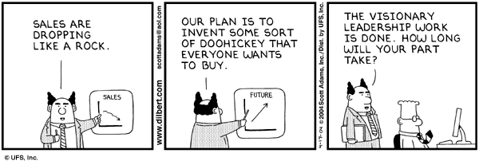
Dilbert on Leadership

Slide 4
Why Leadership Matters?
Year
effect
Industry
effect
Company
value
Company
effect
Leader
effect
In some markets, the leader effect accounts for up to 40% of the variance in value
Source: “When Does Leadership Matter?”, Wasserman, Nohria and Anand, Harvard Business School working paper no. 01-063, April 2001

Slide 5
Levers that Drive Your Career
C-Level
People Decisions
Career Progression
Career Decisions
Early career
Education / Trainings
Student
Genetics
Time

Slide 6
The “Compass” for Managing a Successful Career
Start with Self-Awareness
Identify Individual Values and Objectives
Align Self with the Company & Market
Develop Capability / Competency
Build on Key Career Drivers

Slide 7
Self-Awareness as a Starting Point
More than 3000 years ago …
Today, the advice still has validity ...
“We need to know our strengths in order to know where we belong.”
Peter Drucker, Managing Oneself, HBR 03-04/99
“Know Thyself”
“The […] discovery begins with uncovering the reality: how you see yourself, and how others see you.” Daniel Goleman, Primal Leadership
γνώθι σεαυτόν
Inscription over the Oracle of Delphi
“… until you truly know yourself, strengths and weaknesses, know what you want to do and why you want to do it, you cannot succeed in any but the most superficial sense of the word.”
Warren Bennis, On Becoming A Leader

Slide 8
Individual Values and Objectives
For each of us there are different values and objectives:
Power
Quality of life
Financial rewards
Social status
Meaning
Impact
Community
Look at the career-life balance: there is risk when this relationship gets unbalanced for longer periods of time.

Slide 9
Managing Your Career Means Aligning The Market, The Company And The Individual
Individual – Competencies
Market – Trends in the External Environment

Slide 10
Alignment between the Company & Individual
Corporates want employees that Are
Employees search for
Innovative
Risk takers
Committed
Change agents
Team leaders
Responsibility
Impact
Enjoy work as part of life
A learning platform
Respected team member
Results driven to help grow the business
Personal brand development
High ROI
Long term impact (+ income)

Slide 11
Capability Development
Training is everything. The peach was once a bitter almond; cauliflower is nothing but cabbage with a college education – Mark Twain

Slide 12
Learning New Competencies is a Prerequisite for Successful Careers
Example of a career progression
Functional Expert
Middle Management
Executive
Role
Doing the job
Getting somebody to do the job
Aligning the organization
Sample
key
competencies
Be the go-to expert for technical questions
Results Orientation
Team Leadership
Results Orientation
Change Management
Results Orientation
Strategic Orientation
People Development
Build credibility through leadership skills more than through functional expertise
Think outside of own functional area or division or team to see (and shape) the big picture
Point of transition

Slide 13
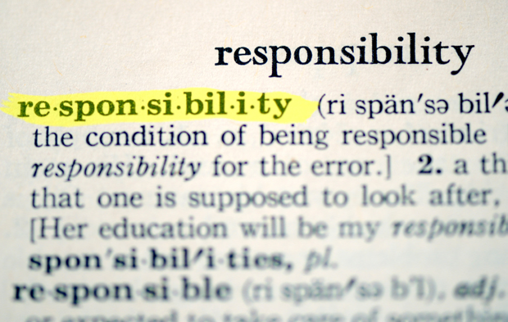
Understanding the difference between Achievements and Responsibilities
What you did?
How well you did it?

Slide 14
Key Career Drivers
In a successful career …
… what does not matter
… what does matter
There is little relation between intellectual capabilities and career: I.Q. explains only 5% to 25% of a successful manager. (Goleman)
Technical/specialists competencies do not always correlate with successful careers (Stenberg)
Successful managers have very different MBTI profiles:
Introverted ⬅➔ Extroverted
Sensitive ⬅➔ Intuitive
Feeler ⬅➔ Thinker
Perceiver ⬅➔ Judger
Motivation
Attitude
Experiences
Competencies
RESULTS

Slide 15
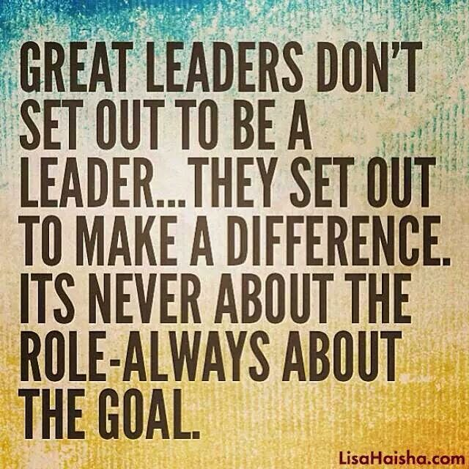
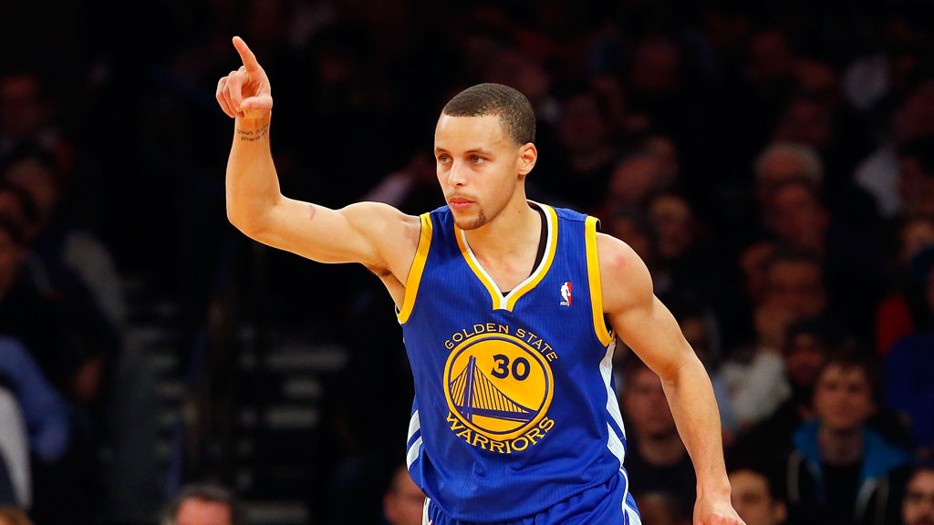

Slide 16
Key Career Drivers: Results
Results, the “bread and butter” of a successful career:
A track record of tangible results in the current job, both in:
Building teams and growing people that work for you
Creating bottom-line impact
Figures among the most important credentials for accessing higher levels of executive responsibility
Usually, appointments into executive positions follow a stringent reference check – and the quality of a reference is driven to a large extent by the results achieved
To obtain tangible results and provide for adequate succession requires time, often 3-5 years
Hiring officers (both HR and line) tend to look with suspicion at managers with a track record of “job hopping”

Slide 17
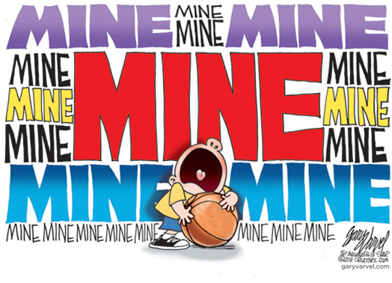
Your Career Is Your Own Responsibility
CAREER
Develop your OWN
personal brand and career trajectory

Slide 18
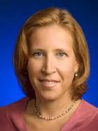
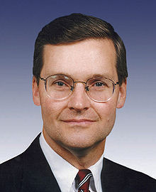
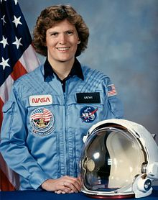
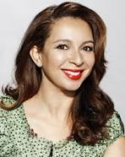
Don’t chase someone else’s definition of success, create your own
Susan Wojcicki
Senior Vice President, Ads and Commerce
Susan D. Wojcicki is the senior vice president in charge of Ads and Commerce platform at Google. In September 1998, the same month that Google was incorporated, its founders Larry Page and Sergey Brin set up office in Susan's garage in Menlo Park. Wojcicki, called "the most important Googler you've never heard of", was 16th on Forbes Magazine's List of The World's 100 Most Powerful Women in 2011
John Doolittle
Member of the U.S. House of Representatives
from California's 4th district
John Taylor Doolittle (born October 30, 1950), American politician, was a Republican member of the United States House of Representatives from 1991 to 2009, representing California's 4th congressional district. In the 109th Congress, he held a leadership role as the Deputy Whip for the Republican party in the House..
Kathryn D Sullivan
Astronaut, Oceanographer & Asst. Secretary of Commerce
Kathryn Dwyer Sullivan is an American geologist and a former NASA astronaut. A crew member on three Space Shuttle missions, she is the first American woman to walk in space. Dr. Sullivan performed the first EVA by an American woman during Space Shuttle Challenger mission STS-41-G on October 11, 1984. She flew on three space shuttle missions and logged 532 hours in space. In 1988, Dr. Sullivan joined the U.S. Naval Reserve as an oceanography officer, retiring with the rank of Captain in 2006. On May 4, 2011, Dr. Sullivan, was confirmed by unanimous consent of the U.S. Senate and appointed by President Obama to serve as assistant secretary of commerce for environmental observation and prediction and deputy administrator for the National Oceanic and Atmospheric Administration.
Maya Rudolph
Actress
Maya Khabira Rudolph is an American actress and comedian. She was a background singer and keyboardist for rock band The Rentals until they disbanded, and became a member of improvisational comedy troupe The Groundlings. Rudolph rose to prominence on the NBC television show Saturday Night Live, where she was a cast member from 2000 to 2007. She has also starred in a number of films such as Idiocracy (2006), Away We Go (2009), Grown Ups (2010), Bridesmaids (2011), and Grown Ups 2 (2013). She starred as Ava Alexander in the NBC sitcom Up All Night from 2011 to 2013.

Slide 19
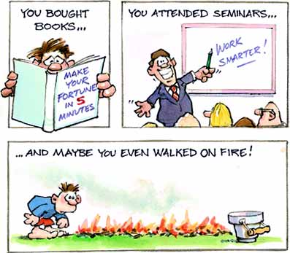
Hurrah! You’re successful !!!
But …
… Success is not the key to Happiness. Happiness is the key to Success. If you love what you are doing, you will be Successful – Herman Cain

